Slide 1
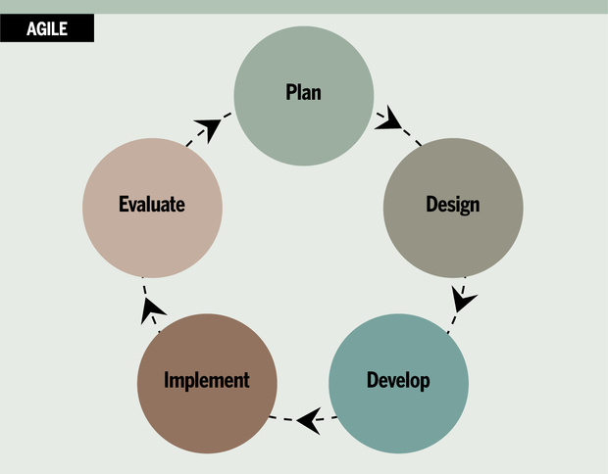
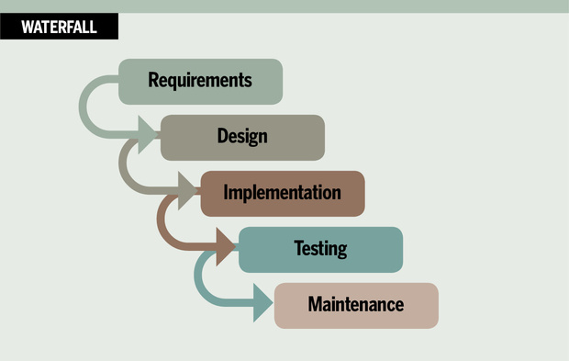

Development Management
Agile VS Traditional methodologies for game development
Notes:
Hello my name is Lewis, In this video I will evaluate project management methodologies, and advice and recommendation of the most optimal methodology for game development.

Slide 2
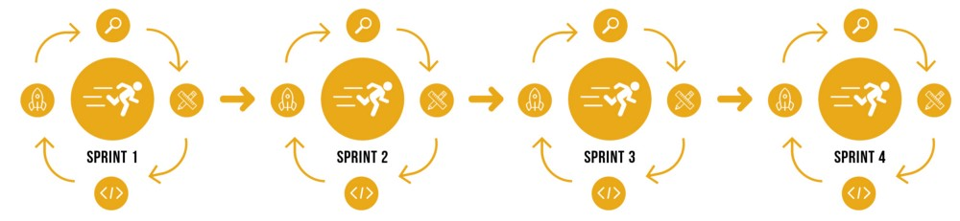
Iterative Development

Slide 3

Traditional Development
Notes:
Pros and cons of both

Slide 4
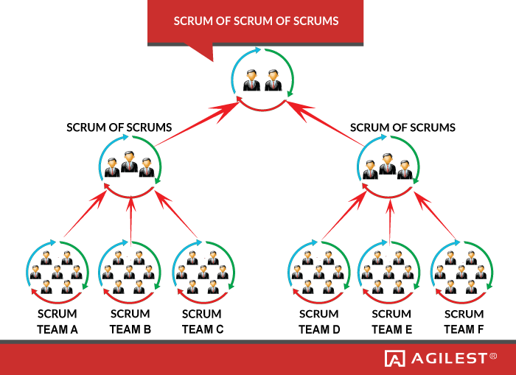
Scrum
Notes:
Scrum is an iterative development process that incorporates close cooperation between employees. A key

Slide 5
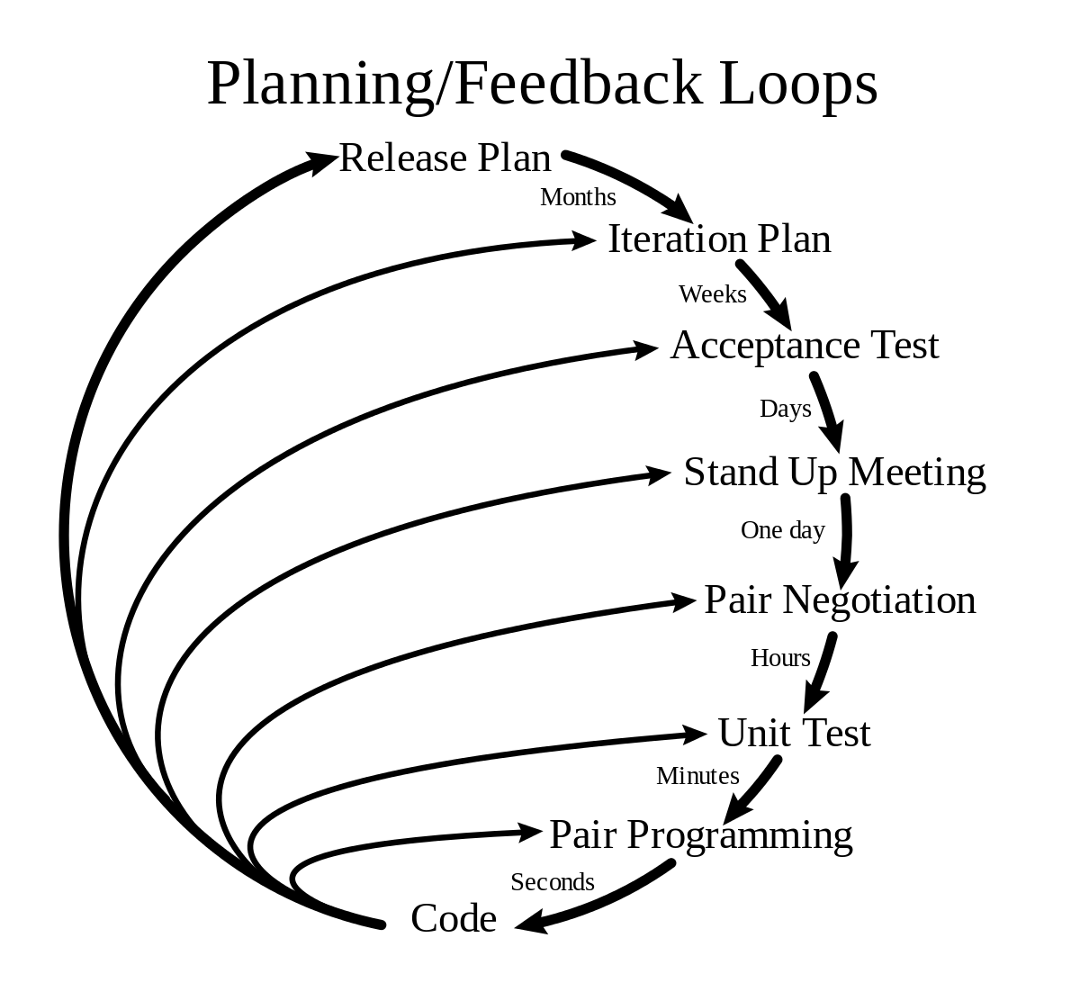
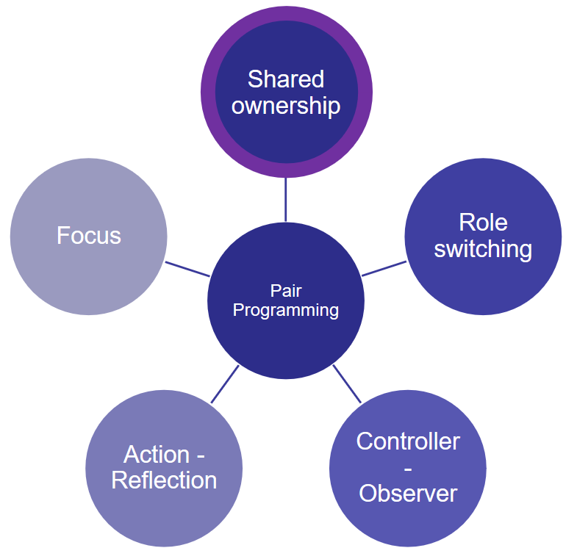
eXtreme Programming (XP)
Notes:
XP Enforces communication by introducing many practises that could not be carried out without communicating e.g. pair programming, XP takes this a step further and employer a role called the coach, the coaches jobs is to check when people are communicating and rectify the situation. The coach also make sure that the project stay on course.
Pair programming, is a simple straightforward concept. Two programmers work side by side at one computer, continuously collaborating on the same design, code and testing. It allows two people to create higher quality than produced from solitary efforts. Other benefits reduced cycle time, enhanced learning with sharing of knowledge between both programmer, improve team work and relationship and overall 2 head's is better than 1.

Slide 6
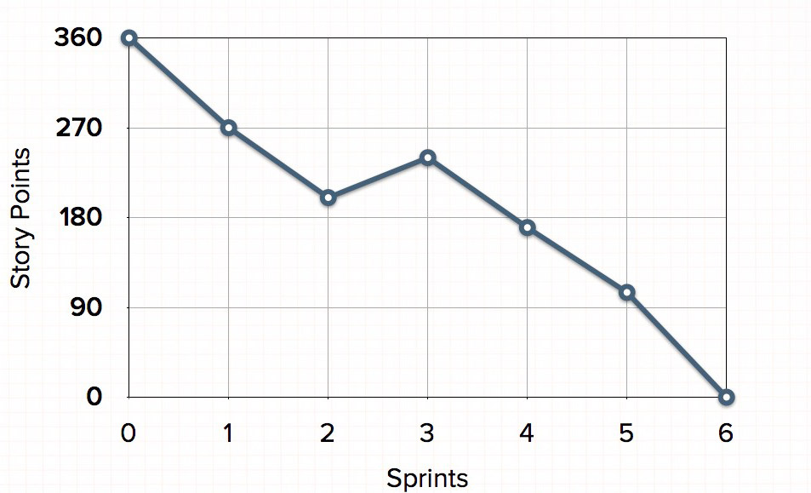
Tools
Notes:
it

Slide 7
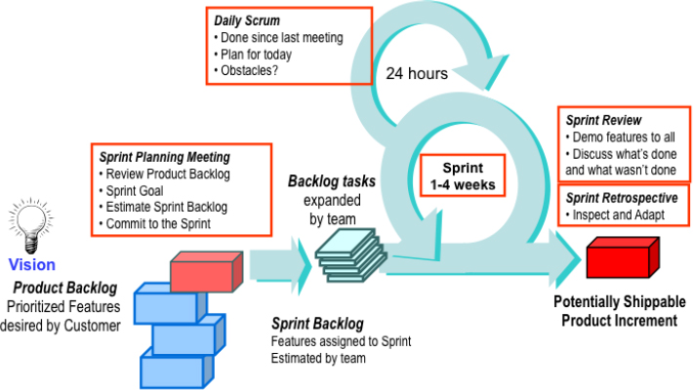
Recommended Method
Notes:
it

